Slide 1
APRIL 15, 2020
Community Anchor Institution Connectivity
MODERATOR
John Windhausen,
Executive Director of the Schools, Health & Libraries Broadband Coalition
PANELISTS
Alton Kimura, Senior Loan Specialist, USDA Rural Development
Tammy Lange, Vice President of Sales, FatBeam
Garry Lough, Director of Government Relations West, Education Networks of America
Andrew Moore, CIO, Boulder Valley School District
Graham Taylor, Senior Account Executive, FatBeam

Slide 2
Community Facilities Loan and Grant Program
Western Governors’ Association Webinar
April 2020

Slide 3
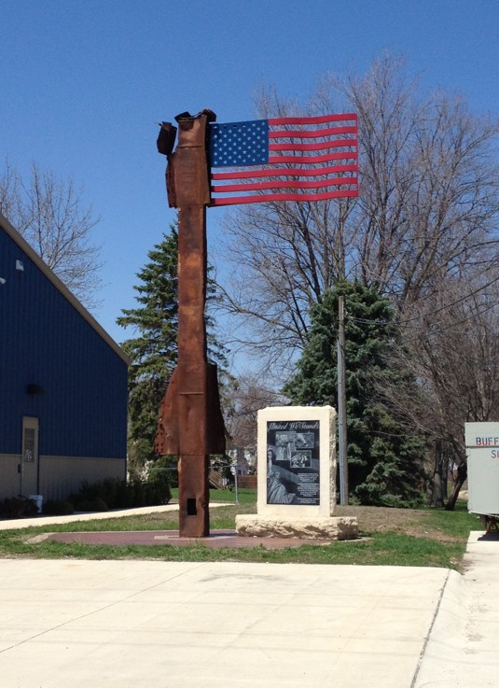
Community Facilities Overview
Community Facilities Programs
Community Facilities Programs offer direct loans, loan guarantees and grants to develop or improve essential public services and facilities in communities across rural America.
These amenities help increase the competitiveness of rural communities in attracting and retaining businesses that provide employment and services for their residents
These facilities improve the basic quality of life, and assist in the development and sustainability of rural America.

Slide 4
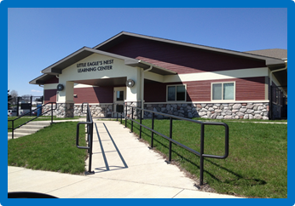
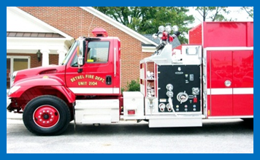
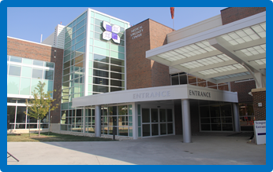
Community Facilities Overview
Essential Community Facilities
Public Safety Facilities
Public Buildings & Equipment
Health Care Facilities & Equipment
Education & Cultural Facilities
Infrastructure
Eligible Applicants
Public Bodies, Non Profits or Indian Tribes
Communities less than 20,000 residents
(50,000 for Guaranteed loans)

Slide 5
Community Facilities Overview
Eligible Purposes
Acquire existing real estate
Construct, expand, renovate, or improve facilities
Purchase vehicles and major equipment
Associated project expenses (i.e. legal fees, interest expense)
Refinancing when it is less than 50% of the total loan

Slide 6
Community Facilities Overview
CF Direct Loan Rates and Terms
Interest rates currently at 2.375% fixed for the loan term
40-year term or useful life
Adequate security to protect the interest of the Government
Demonstrate adequate repayment ability
Unable to obtain other commercial credit

Slide 7
Community Facilities Overview
CF Guarantee Rates, Terms, and Fees
Lender driven process
Interest rate set by lender (fixed or variable)
Term set by lender (max 40 year term or useful life)
Adequate security to protect the interest of the Government
Lender must be unable to make loan without guarantee
Up to a 90% guarantee on any loss
One time, one percent (1.5%) fee on guaranteed portion, payable upon issuance of Loan Note Guarantee with a 0.5% annual fee

Slide 8
Community Facilities Overview
Other CF Programs
CF Grants – Regular, Economic Impact Initiative (EII) & Tribal College
Limited funds available for the most needy communities
Same eligible purpose as direct loans and guarantees
$150 million for Disaster Grants in PDDA Counties
Rural Community Development Initiative Grants (RCDI)
Technical assistance for capacity building
Technical Assistance & Training Grants (TAT)
For the benefit of developing an essential community facility

Slide 9
Alton Kimura, Senior Loan Specialist Rural Development Community Facilities alton.kimura@usda.gov www.rd.usda.gov

Slide 10
Western Governors' Association, April 15, 2020
ConnectME (My Education) Overview

Slide 11
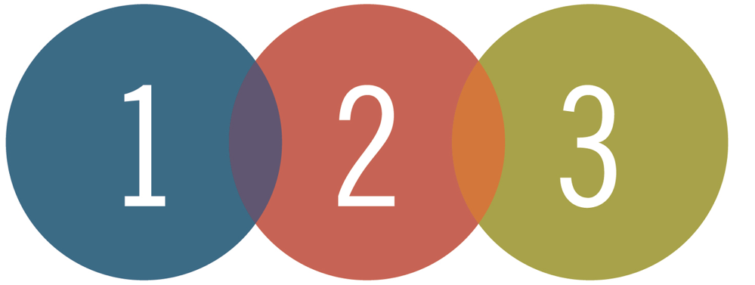
Our Focus on the Three Components of Digital Equity
Computing device access
Broadband access at school, home and within the community
Services to ensure community members have digital literacy skills

Slide 12
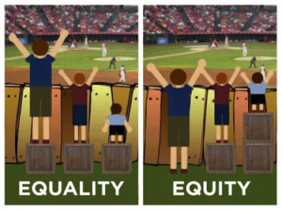
Focus on Equity vs. Equality
As we implement Digital Equity, do we have the right mindset for what we want to accomplish?
What happens
when students leave the school campus?

Slide 13
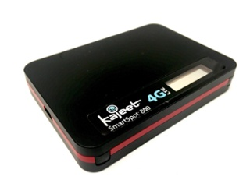
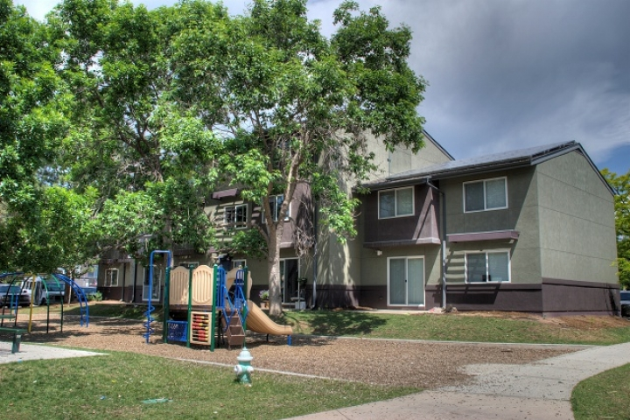
BVSD Attempts at Connectivity at Home
Mobile Hotspots
Poor Cell Coverage
Boulder Housing Partners
Broadway East
FCC Waiver Request
LiveWire Public/Private Partnership
In Pilot Phase
Notes:
HW Gap / Opportunity Gap -- Students without internet are behind before they get started
Students need an equal opportunity to learn

Slide 14
LiveWire Public/Private Partnership Pilot
Exchange school real estate access for providing free internet to free/reduced lunch qualified students (21% of our student population)
Status
March 2017 - pilot started at Sanchez Elementary
2018 - expanded to Angevine Middle and Centaurus High
2019 - expanded to Casey Middle
FCC approved equipment in the 3.5-5 GHz Range

Slide 15
LiveWire Public/Private Partnership Pilot
Backhaul on either microwave or BVSD dark fiber
BVSD CO SB152 override vote in 2015 allows for Livewire to utilize our fiber to provide internet
50 current ConnectME students receiving free internet
Recognized nationally by Congress’s General Accounting Office (GAO) in a report regarding E-Rate

Slide 16
ConnectME (My Education) Next Steps
Formalize a long-term agreement
Negotiate a revenue sharing component
Finalize/Implement a 18-24 month rollout schedule
Prioritize schools close to our highest FRL populated areas
Lafayette Coverage - P2P, Justice High, Ryan, Pioneer
North Boulder - Columbine, Crestview

Slide 17
Questions?

Slide 18
APRIL 15, 2020
Community Anchor Institution Connectivity
MODERATOR
John Windhausen,
Executive Director of the Schools, Health & Libraries Broadband Coalition
PANELISTS
Alton Kimura, Senior Loan Specialist, USDA Rural Development
Tammy Lange, Vice President of Sales, FatBeam
Garry Lough, Director of Government Relations West, Education Networks of America
Andrew Moore, CIO, Boulder Valley School District
Graham Taylor, Senior Account Executive, FatBeam

